Slide 1




Slide 2




Slide 3


















Slide 4
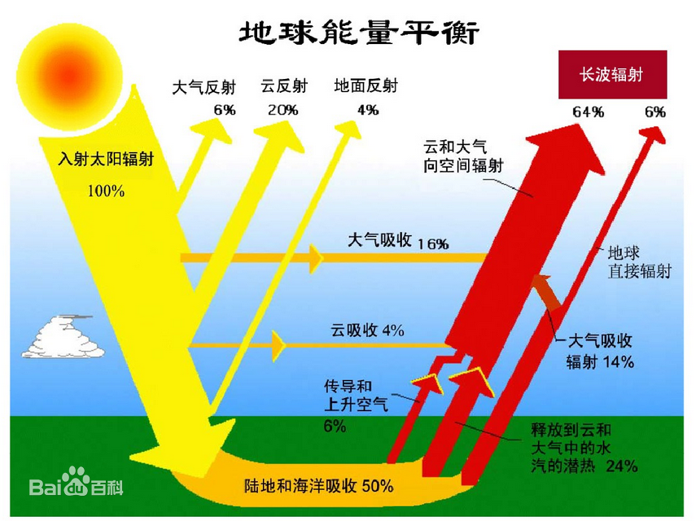



Slide 5
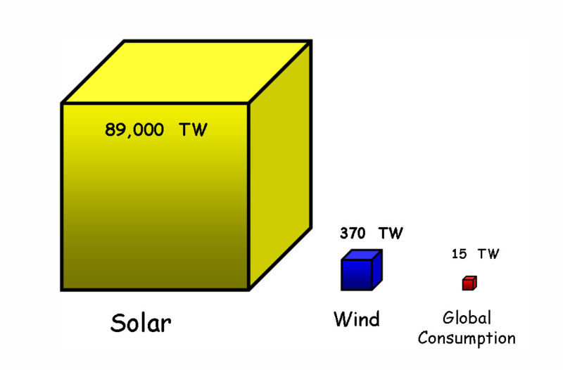









Slide 6















Slide 7











Slide 8










Slide 9
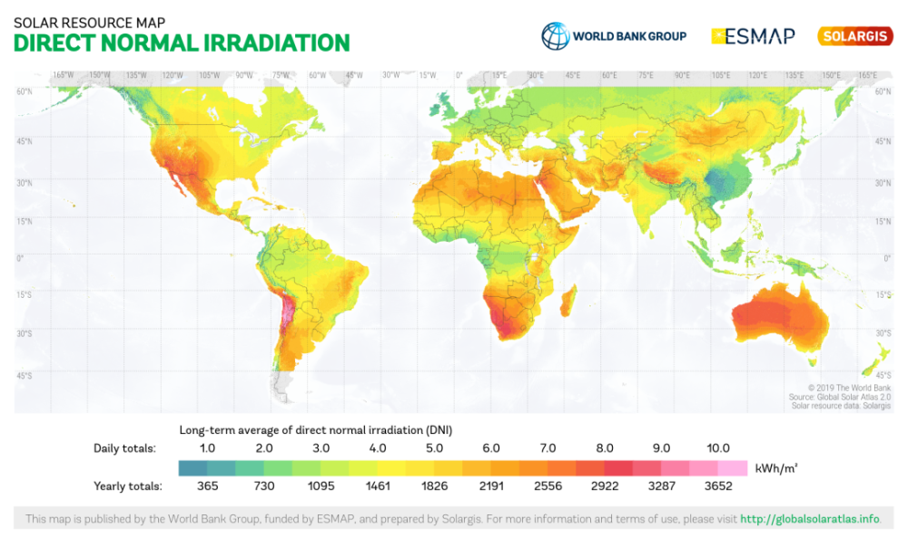


https://globalsolaratlas.info/

Slide 10
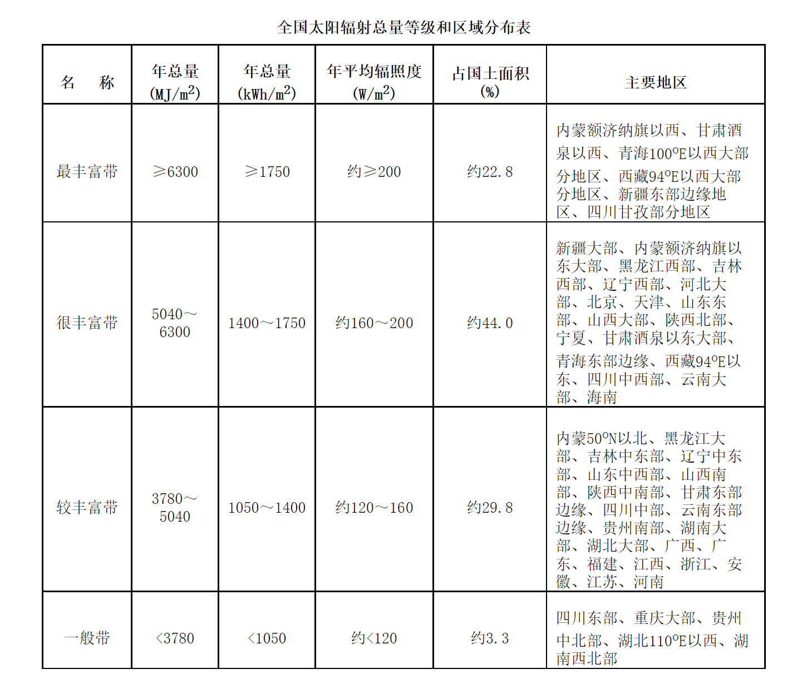





http://www.nea.gov.cn/2014-08/03/c_133617073.htm

Slide 11
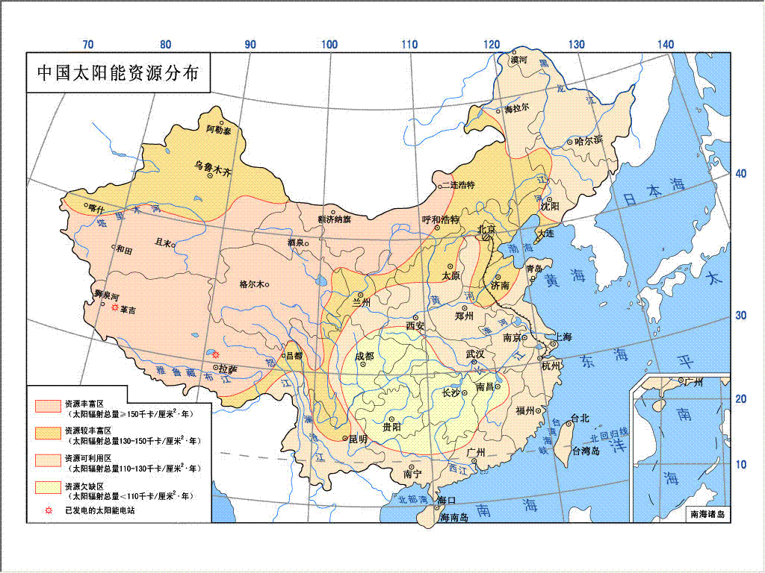

Slide 12












Slide 13








Slide 14










Slide 15
